Slide 1
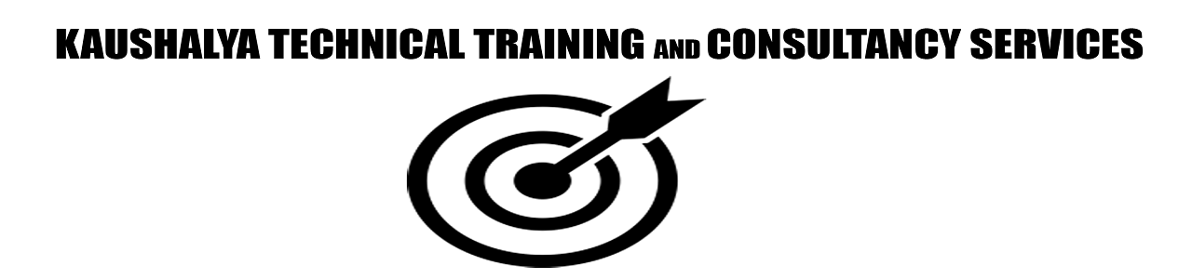
Cloud Computing
Raghu Prasad
9845547471
www.kaushalya.tech
FB : https://www.facebook.com/raghuprasadkonandur/
Skill Up-Skill Re-Skill
Excellence in action

Slide 2
Introduction
Raghu Prasad – BE, MS
Total of 24 years of experience
7 years as a lecturer in an Engineering College
17 Years into IT
Worked with companies like CISCO,CSC,ICICI,First Apex – NTT Data
Currently into Corporate training and consultancy
Worked with corporates and public sector
Service Offerings – In person/On-line/Corporate/Academic Institutes
Technologies – Java,Python,Web technologies,Java Script technologies (MEAN stack),IOT,Test Automation,Machine Learning,Artificial Intelligence,ERP,.NET,Cloud Computing
Customers – Philips,L & T,NextGen,Incarnus,BGS-IT,Sindhi College,Malnad Enginering College,S B College of Management, REVA University

Slide 3
Topics
Introduction to Cloud Computing
Cloud Models
Cloud Providers
Demonstration using Heroku
Version Control System – GIT
Introduction to SDLC

Slide 4
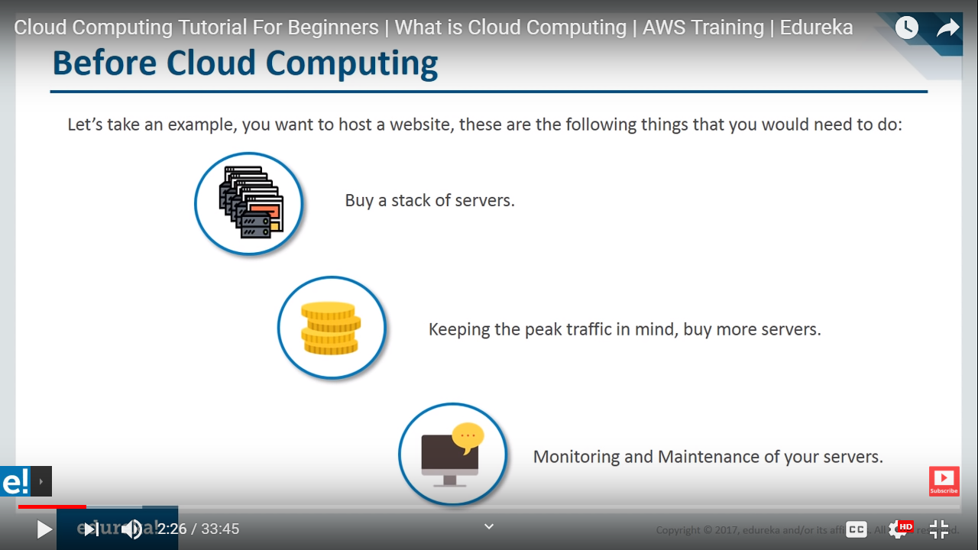
Before Cloud Computing

Slide 5
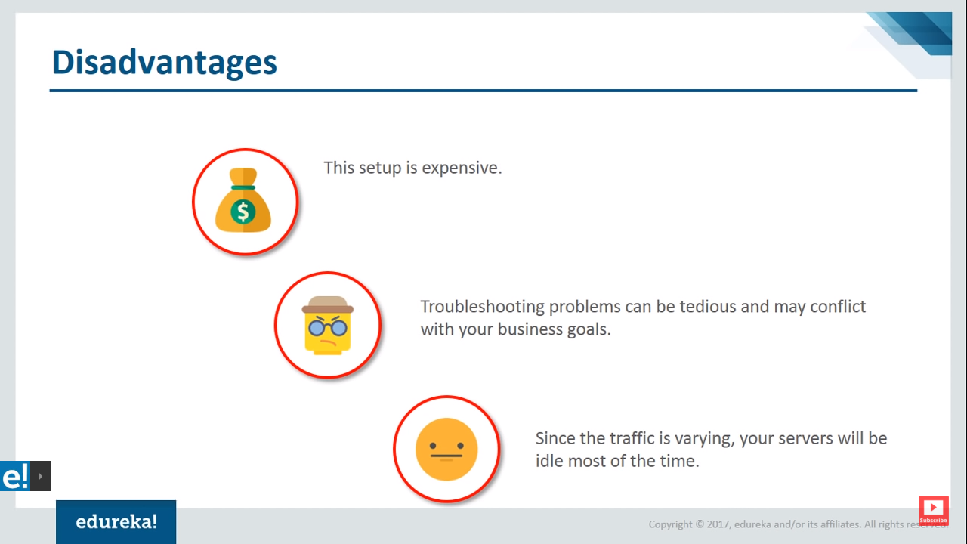
Disadvantages

Slide 6
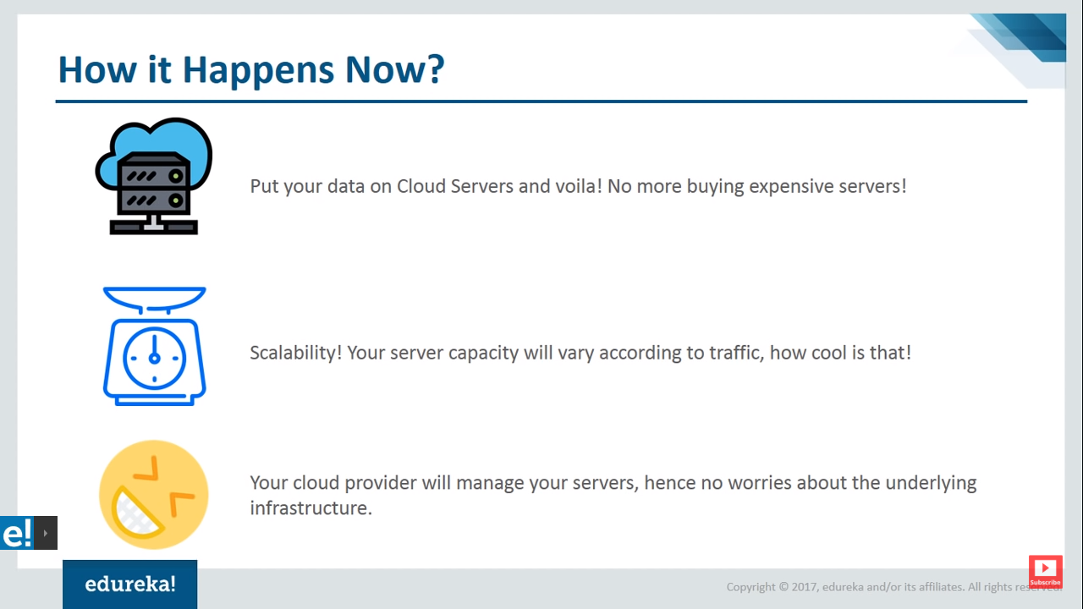
Cloud Computing

Slide 7
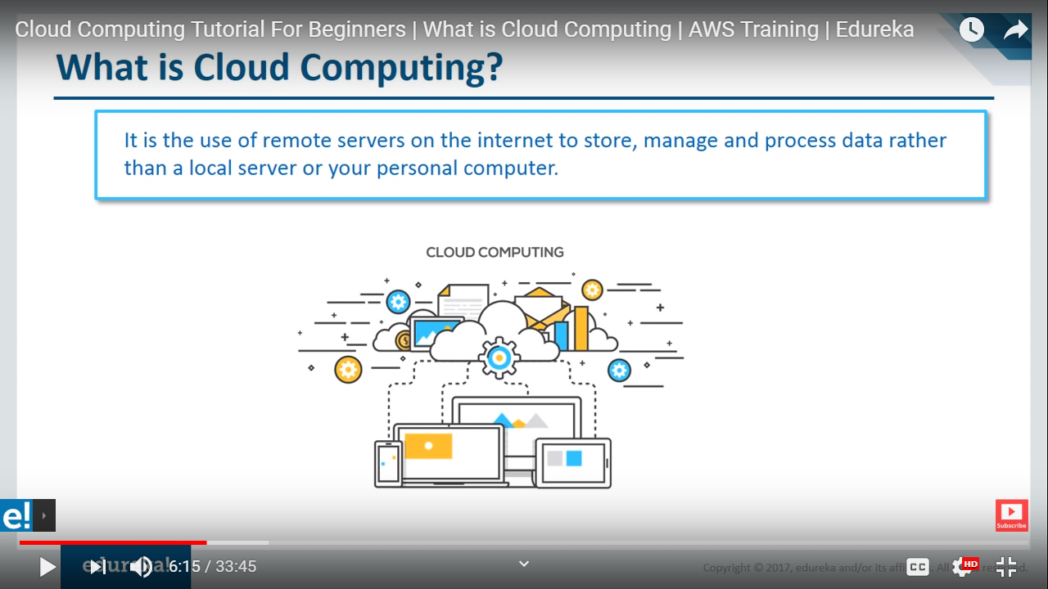
Cloud Computing

Slide 8
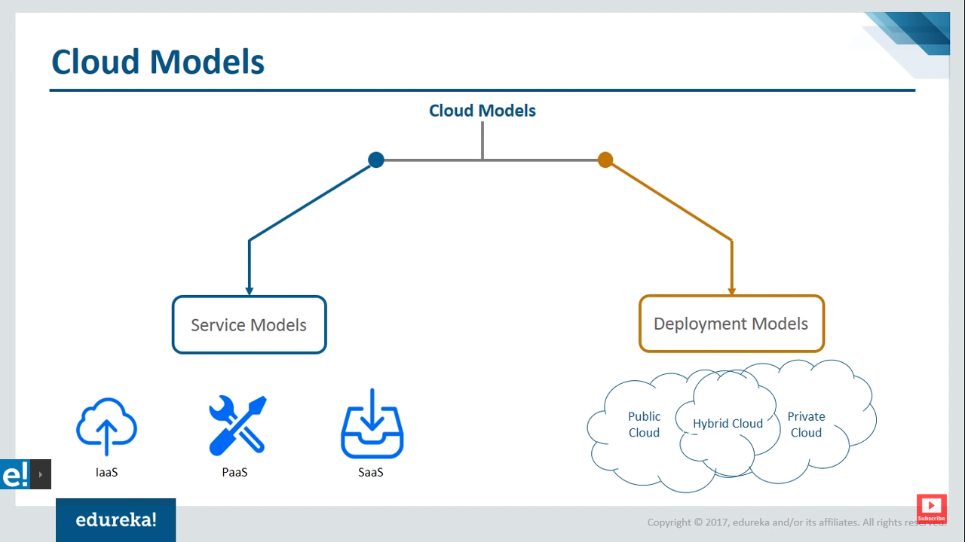
Cloud Models

Slide 9
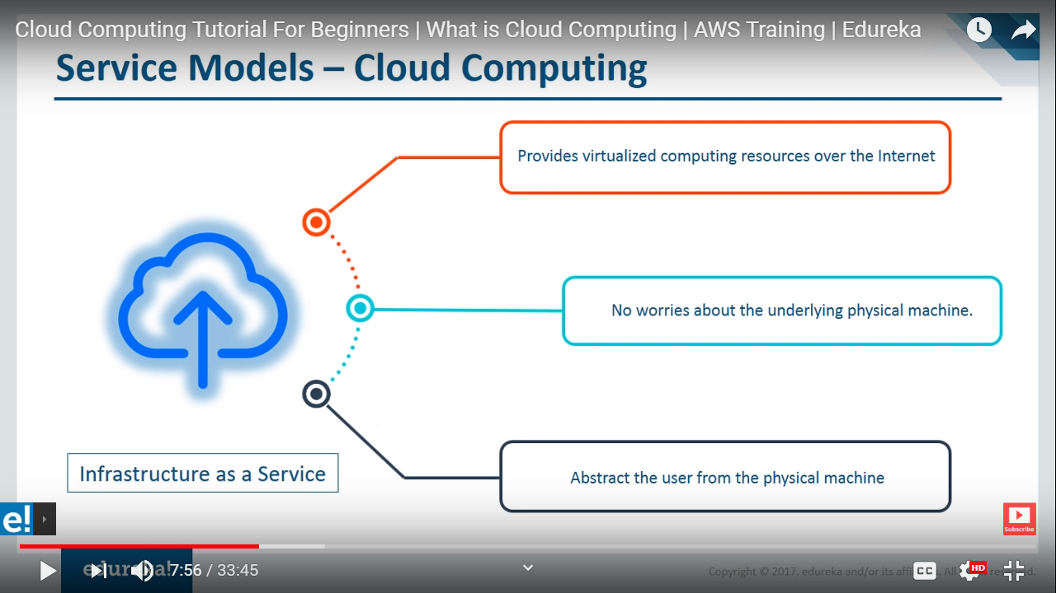
Cloud Models - IaaS

Slide 10
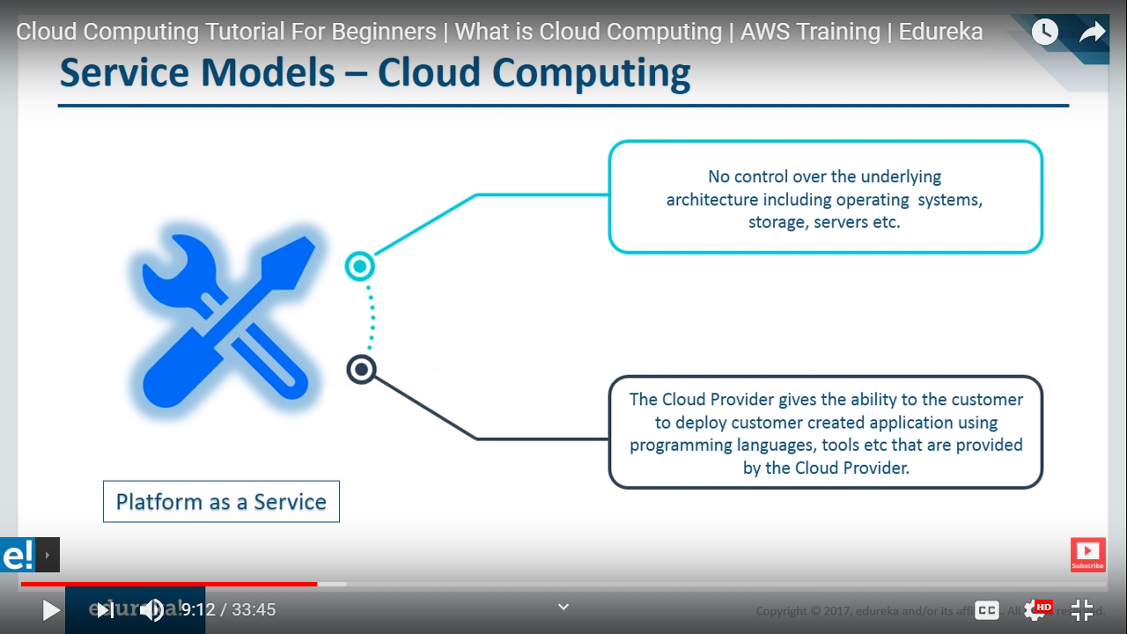
Cloud Models - PaaS

Slide 11
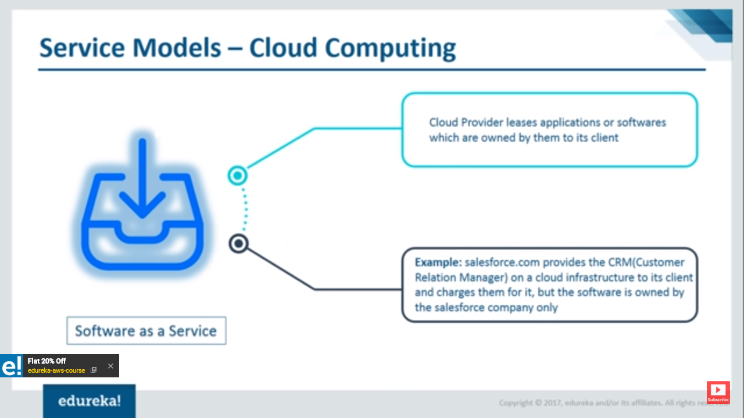
Cloud Models - SaaS

Slide 12
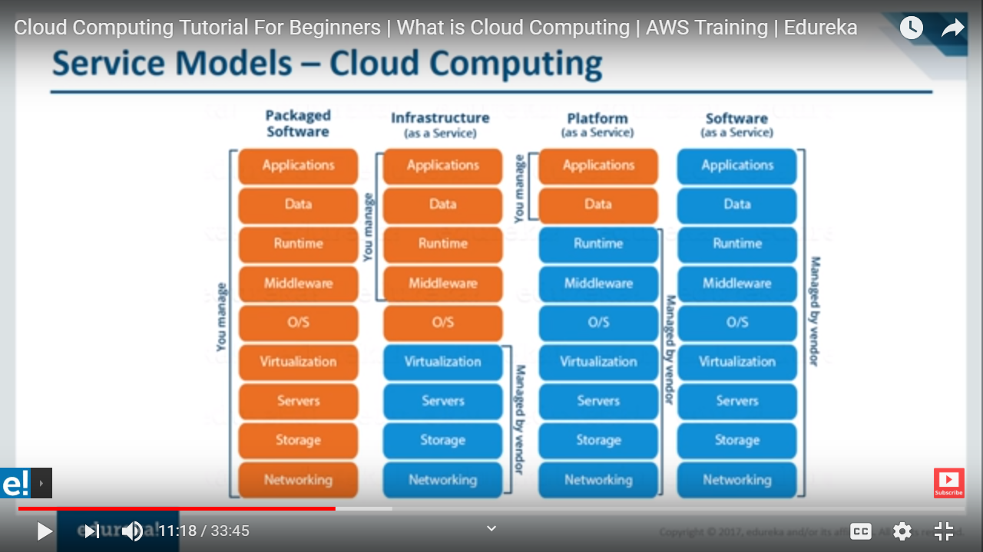
Cloud Models - Snapshot

Slide 13
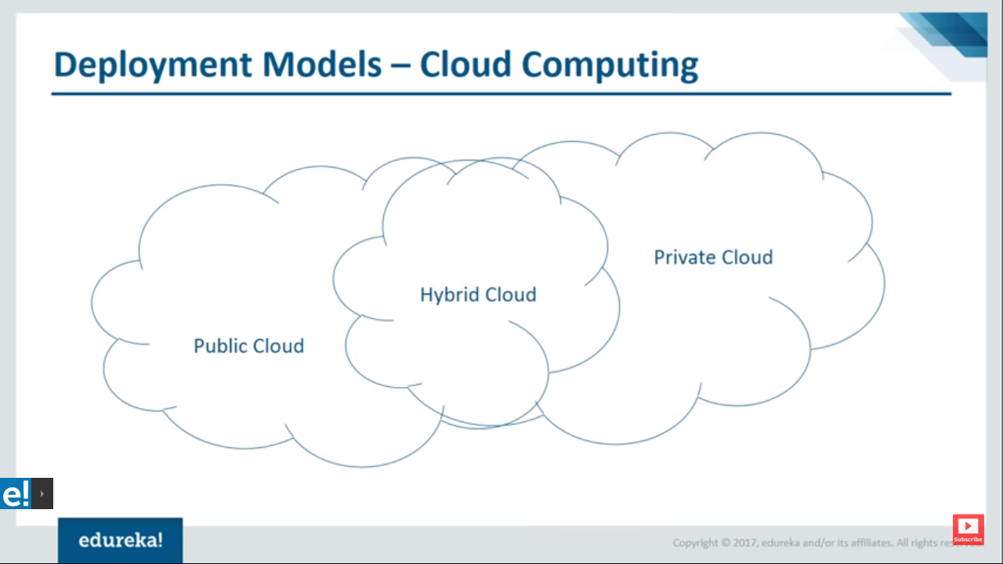
Deployment Models

Slide 14
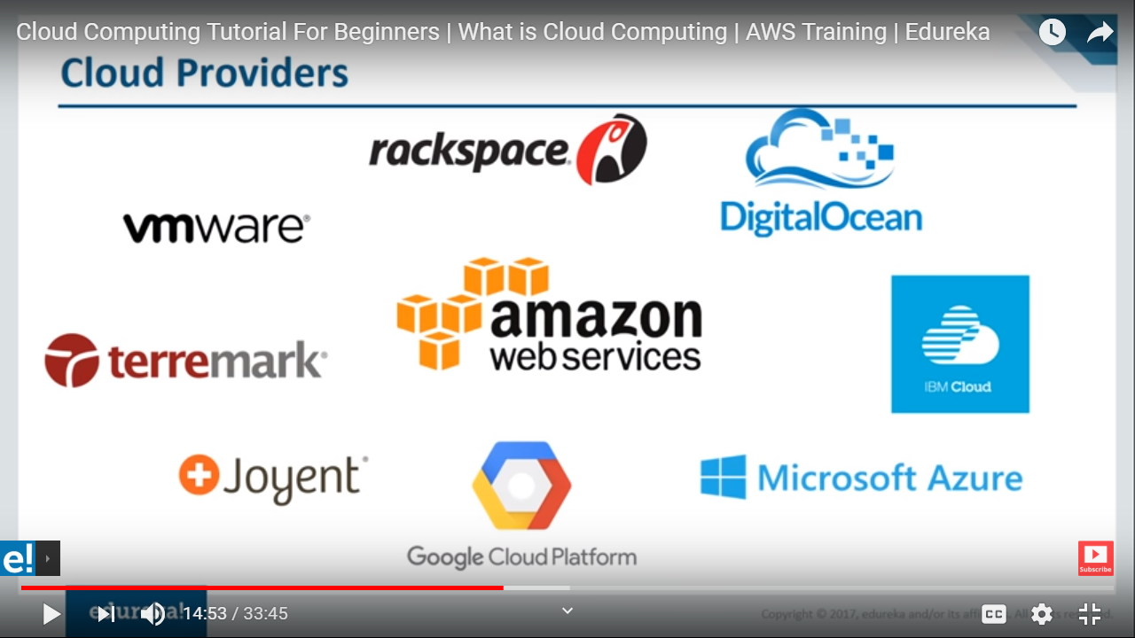
Cloud Providers

Slide 15
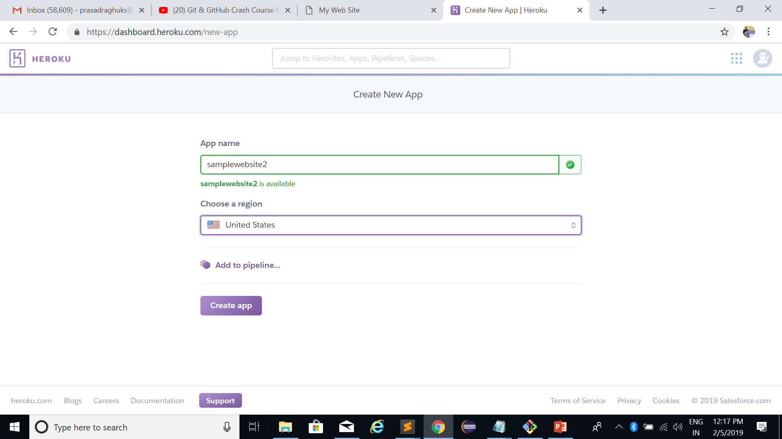
Heroku - Demo

Slide 16
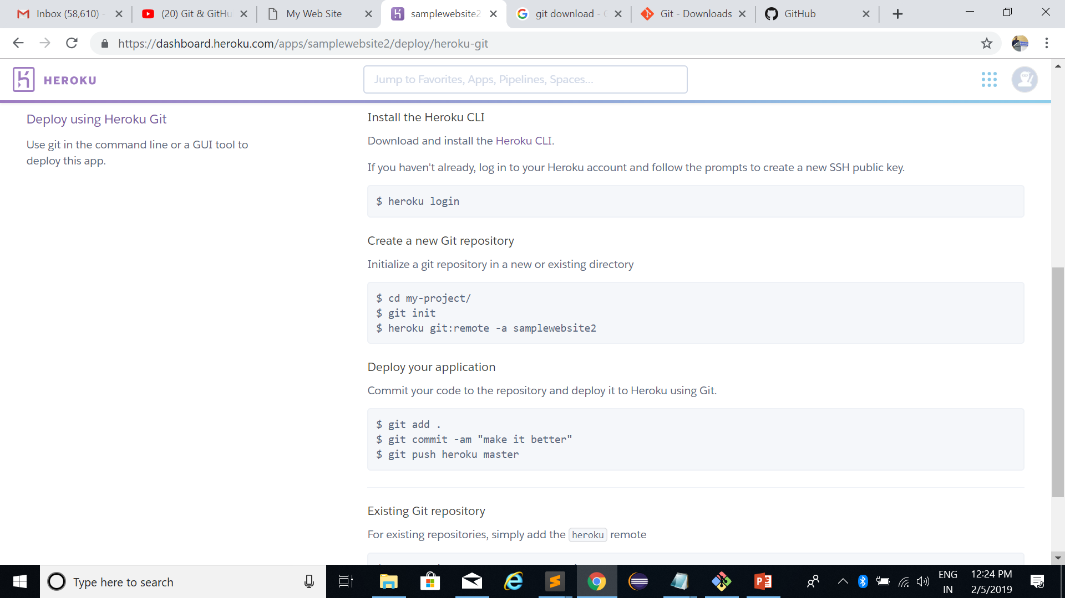
Heroku - Demo

Slide 17
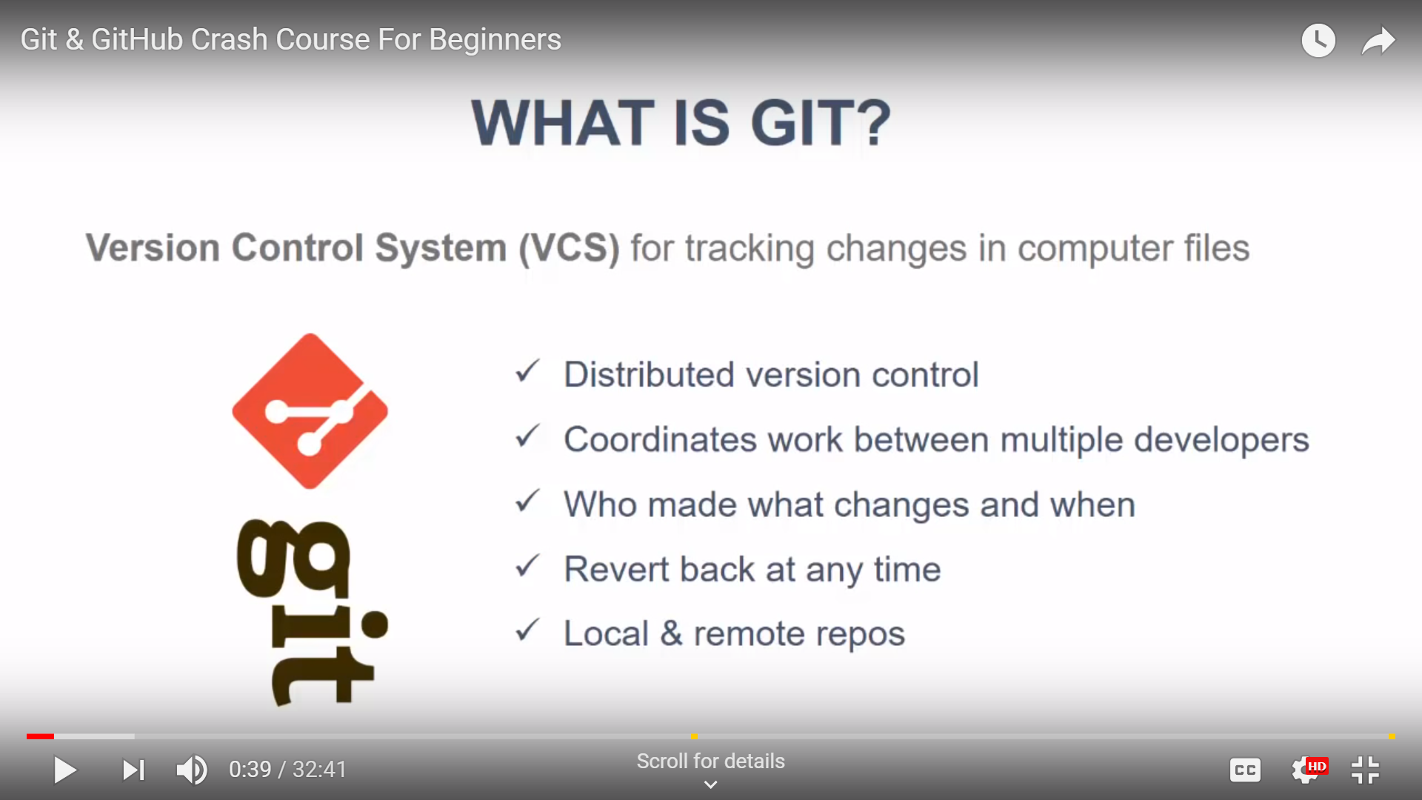
Version Control System - GIT

Slide 18
Git and GitHub
Download GIT
Create an account with GITHUB
https://github.com/

Slide 19
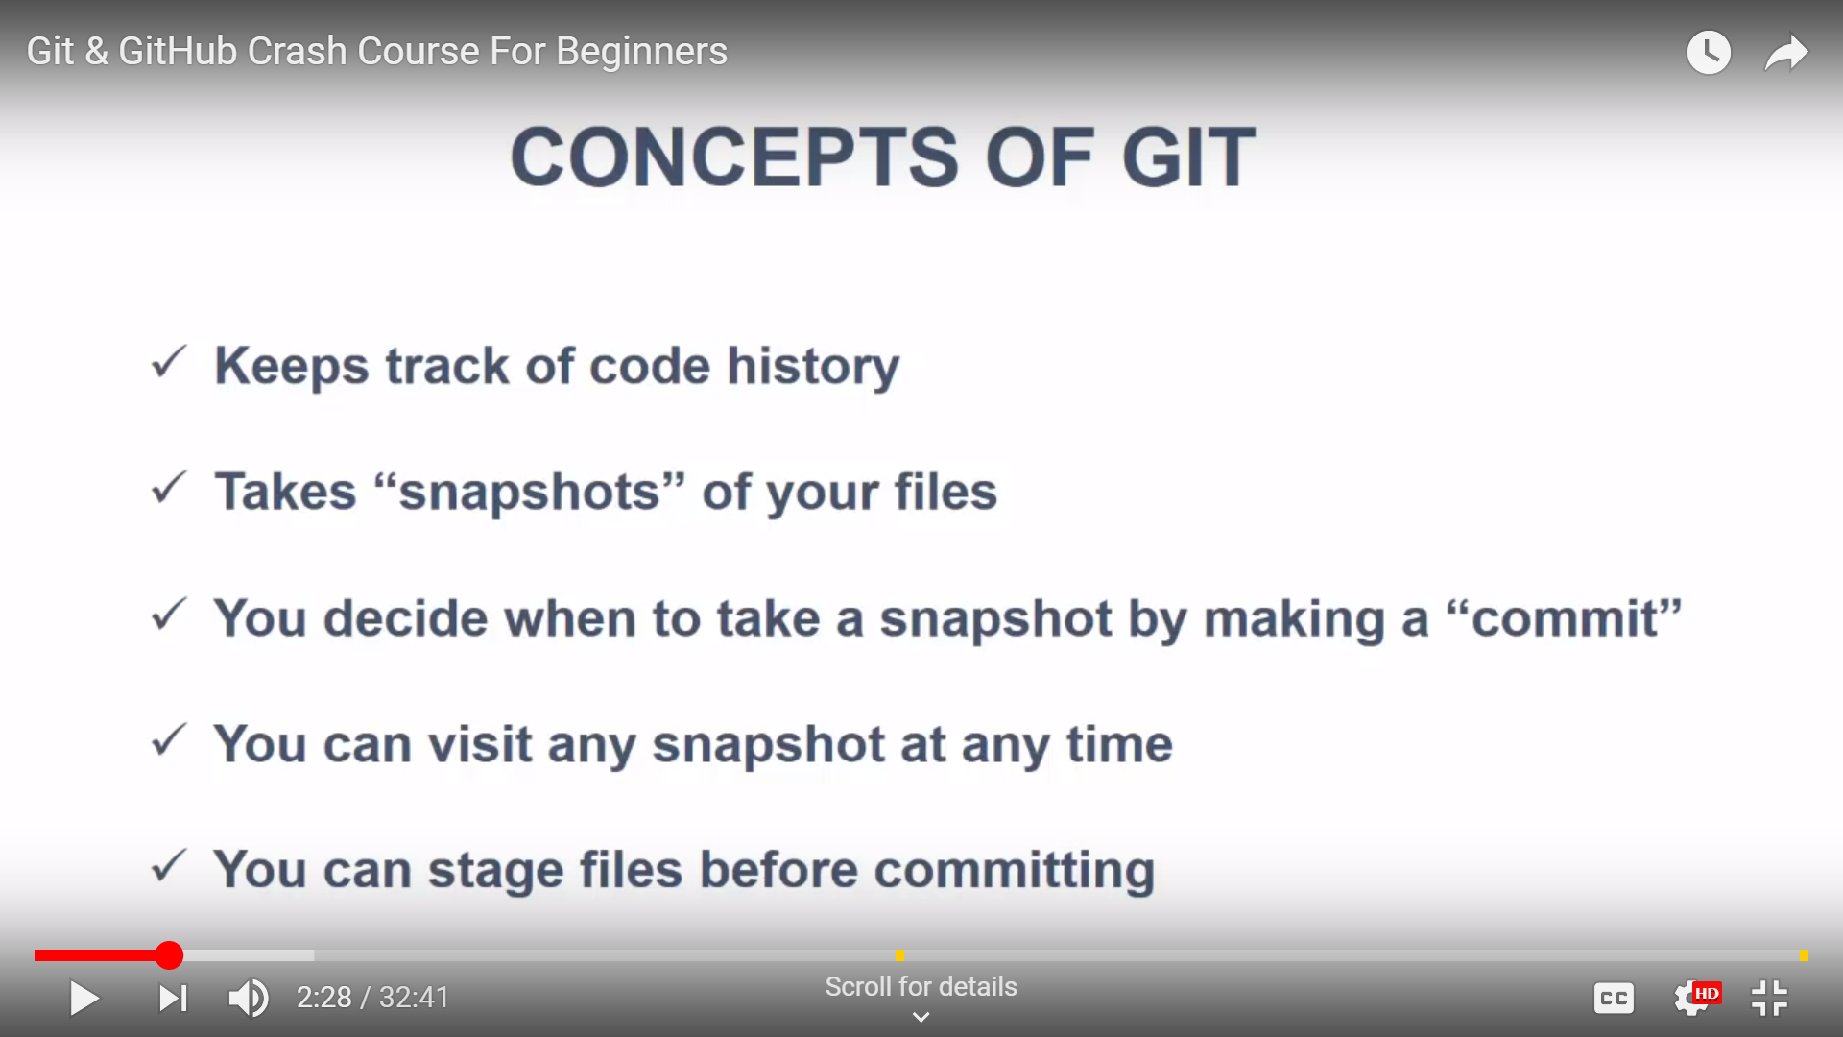
Concepts of GIT

Slide 20
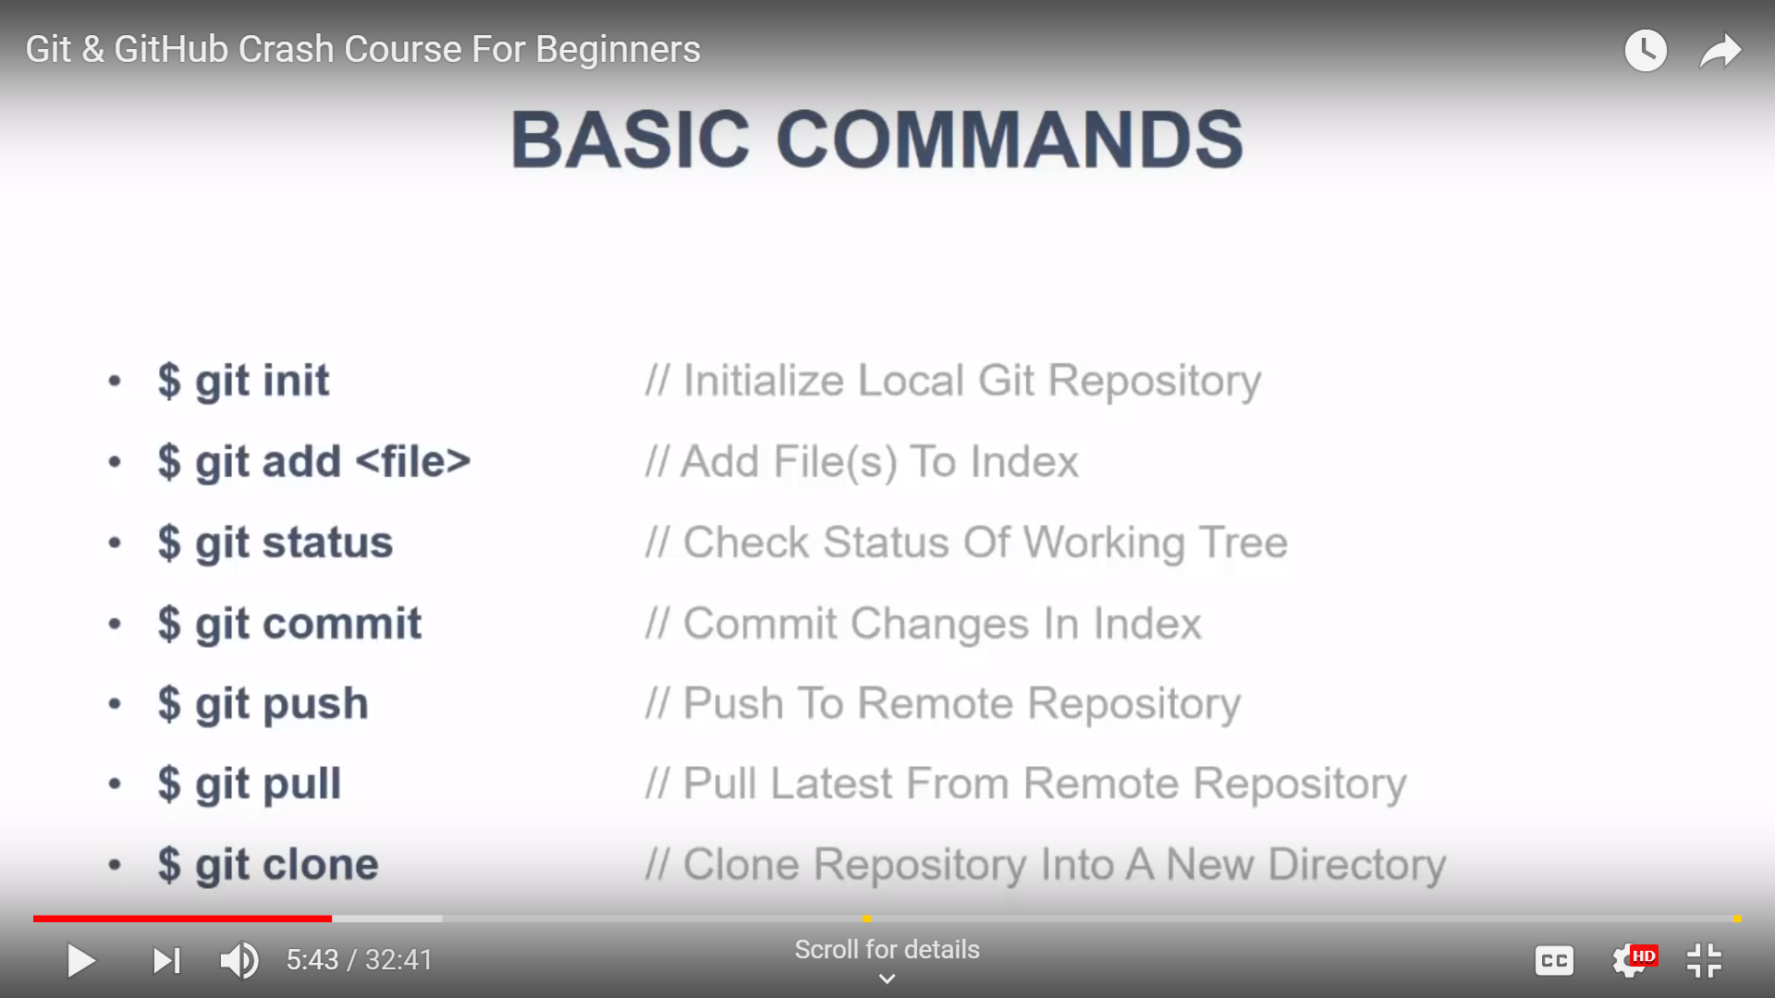
Basic Commands

Slide 21
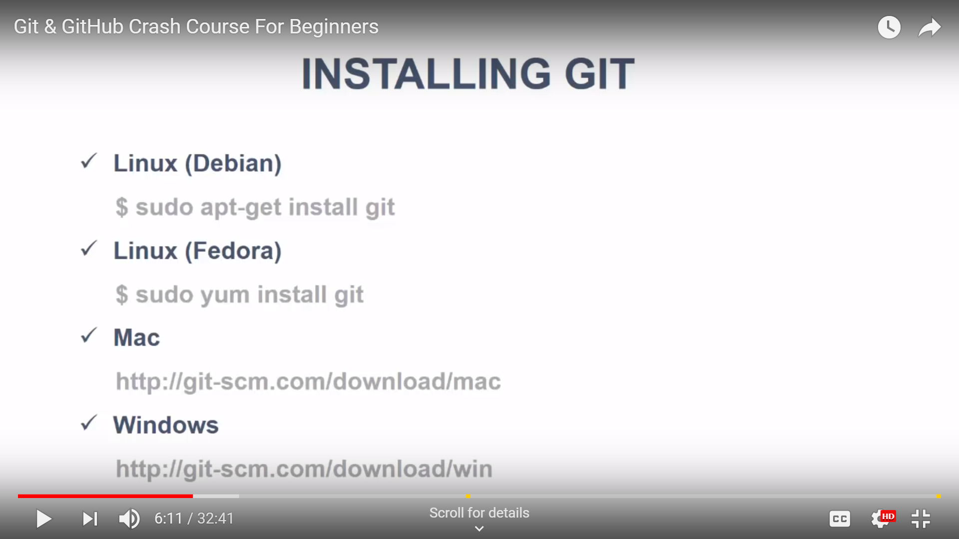
Installing GIT

Slide 22
Introduction to SDLC
Software Development Life Cycle (SDLC) is a process used by the software industry to design, develop and test high quality softwares. The SDLC aims to produce a high-quality software that meets or exceeds customer expectations, reaches completion within times and cost estimates.

Slide 23
Introduction to SDLC
Software Development Life Cycle (SDLC) is a process used by the software industry to design, develop and test high quality softwares. The SDLC aims to produce a high-quality software that meets or exceeds customer expectations, reaches completion within times and cost estimates.
Key SDLC Models
Waterfall
Iterative
Agile Model

Slide 24
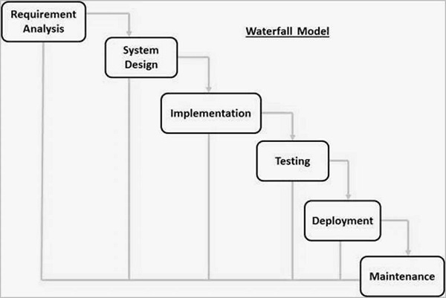
Waterfall Model
The Waterfall Model was the first Process Model to be introduced. It is also referred to as a linear-sequential life cycle model. It is very simple to understand and use. In a waterfall model, each phase must be completed before the next phase can begin and there is no overlapping in the phases.

Slide 25
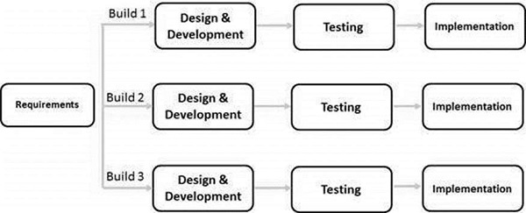
Iterative Model
Iterative process starts with a simple implementation of a subset of the software requirements and iteratively enhances the evolving versions until the full system is implemented. At each iteration, design modifications are made and new functional capabilities are added. The basic idea behind this method is to develop a system through repeated cycles (iterative) and in smaller portions at a time (incremental).

Slide 26
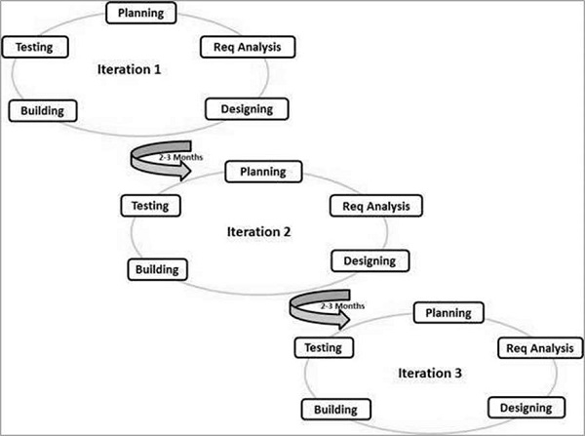
Agile Model
Agile SDLC model is a combination of iterative and incremental process models with focus on process adaptability and customer satisfaction by rapid delivery of working software product. Agile Methods break the product into small incremental builds. These builds are provided in iterations. Each iteration typically lasts from about one to three weeks. Every iteration involves cross functional teams working simultaneously on various areas.

Slide 27
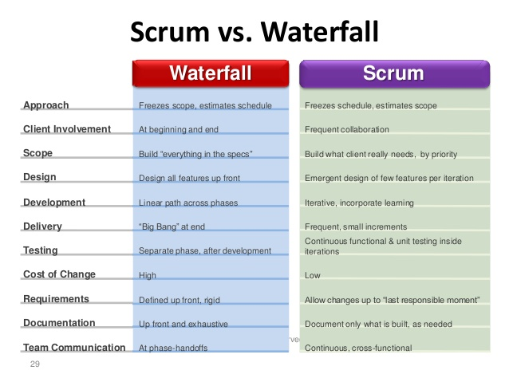
Introduction to SDLC

Slide 28
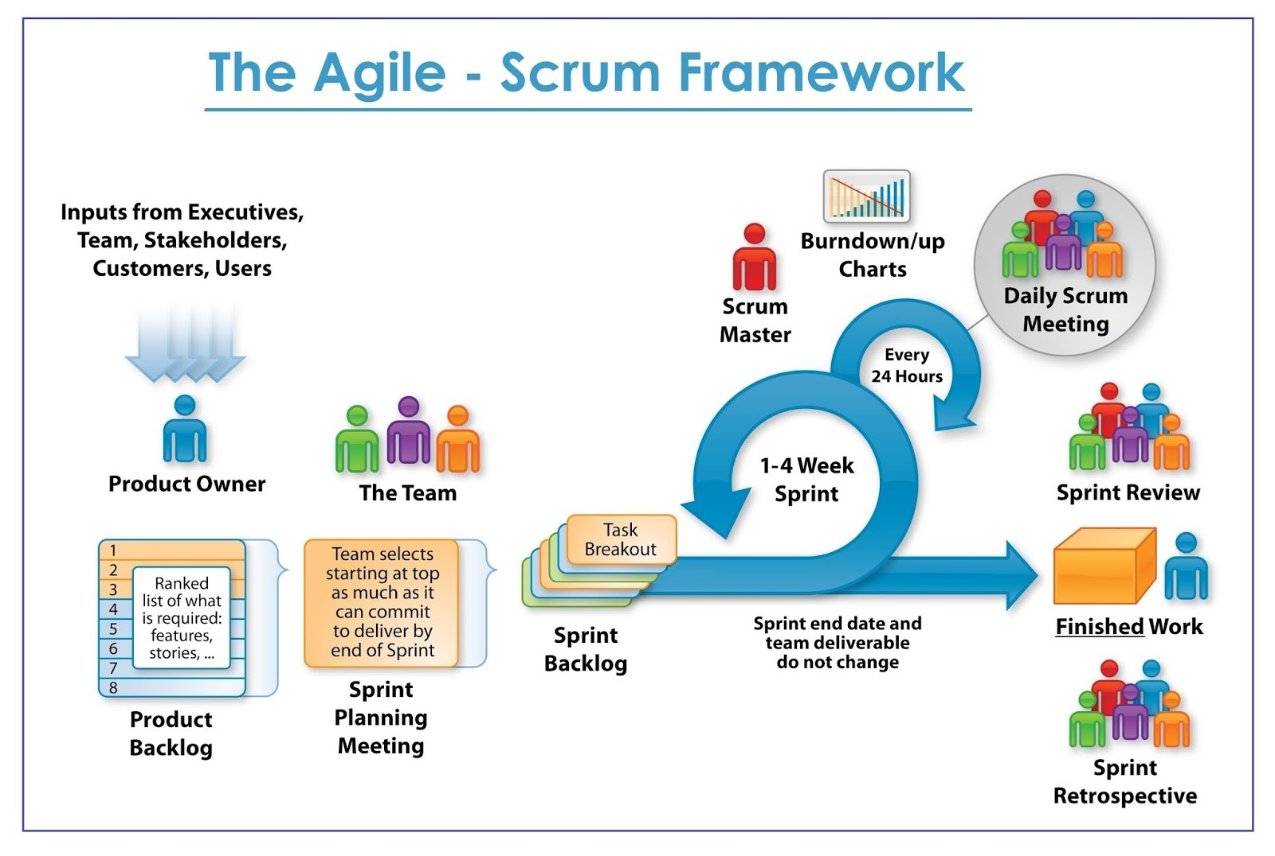
Introduction to SDLC

Slide 29
DevOps
DevOps is a software development method which focuses on communication, integration, and collaboration among IT professionals to enables rapid deployment of products.
DevOps is a culture that promotes collaboration between Development and Operations Team. This allows deploying code to production faster and in an automated way. It helps to increases an organization's speed to deliver application and services. It can be defined as an alignment of development and IT operation.
https://www.guru99.com/agile-vs-devops.html

Slide 30
Thank You
Raghu Prasad
9845547471
www.kaushalya.tech
FB : https://www.facebook.com/raghuprasadkonandur/
Skill Up-Skill Re-Skill
Excellence in action

